Slide 1
Robot Triathlon Performance
Jason Galvao
Michael Cozzolino
Nicholas Stevens

Slide 2

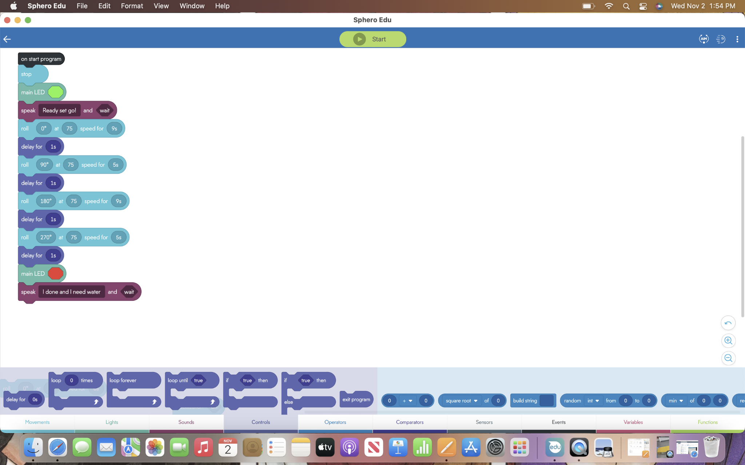
Endurance

Slide 3
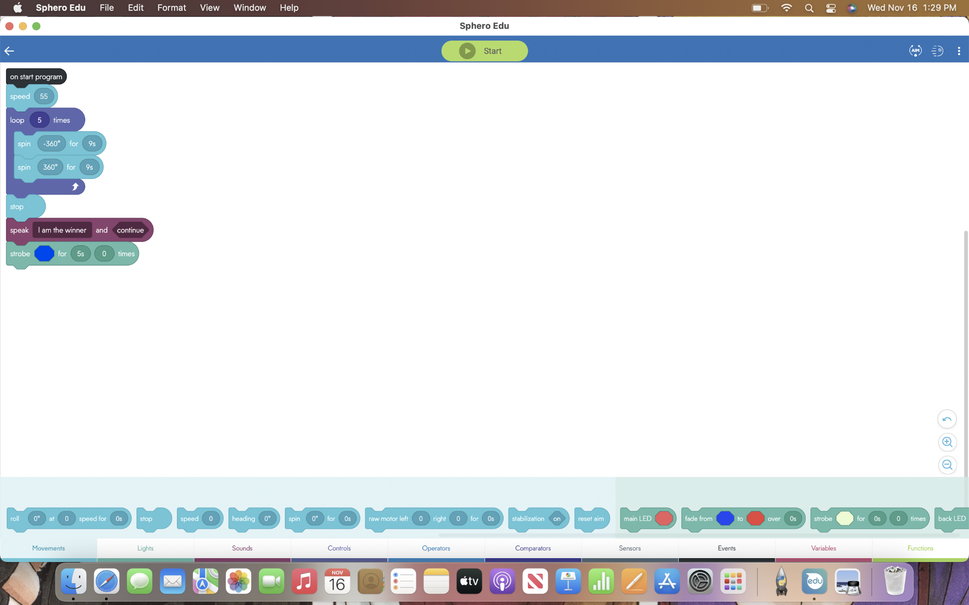
Accuracy

Slide 4
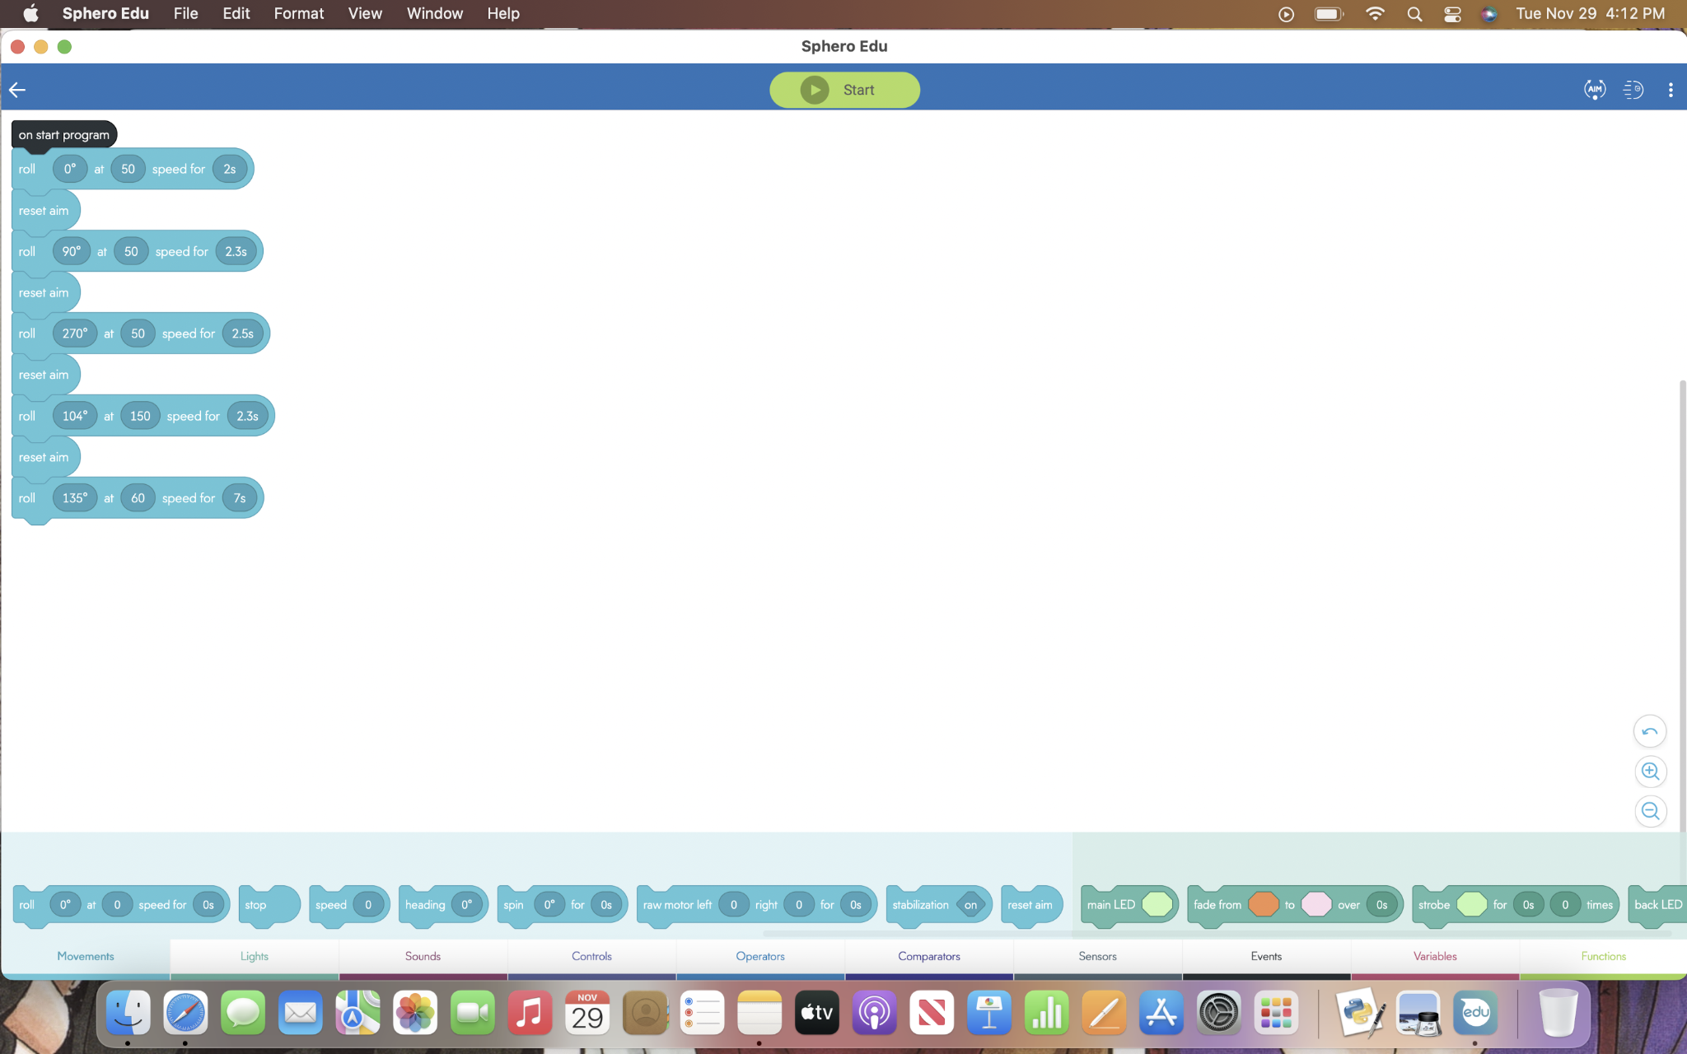
Agility

Slide 5
Roles
Nicholas - Programmer
Jason - Documenter
Michael - Manager (Flowchart, Helped with Document)

Slide 6
What We Learned
It is important to begin planning first before writing your first line of code. By planning beforehand it makes the rest of the process quicker.

Slide 7
Challenges
The robot was very erratic and not consistent so we had to run the same program many times till it worked.
Finding times to work together

Slide 8
What Would Be Done Differently
Our robots and code ran fine, however we made some sloppy mistakes by not including everything on the system design document or forgetting to post something on GitHub. Next time, we should review everything after we finished to make sure we weren’t missing anything

